Slide 1
Urban Growers
Collective
www.urbangrowerscollective.org
@urbangrowerscollective

Slide 2
UGC Overview
Vision:
Urban Growers Collective aims to address the inequities and structural racism that exist through the food system and in communities of color, using urban agriculture as our tool and method for this work.
Mission:
Rooted in growing food we cultivate nourishing environments which support health, economic development, healing and creativity through urban agriculture.
Job Training & Education
Food Access
Community Engagement

Slide 3
UGC operates
8 farms
over 11 acres

Slide 4
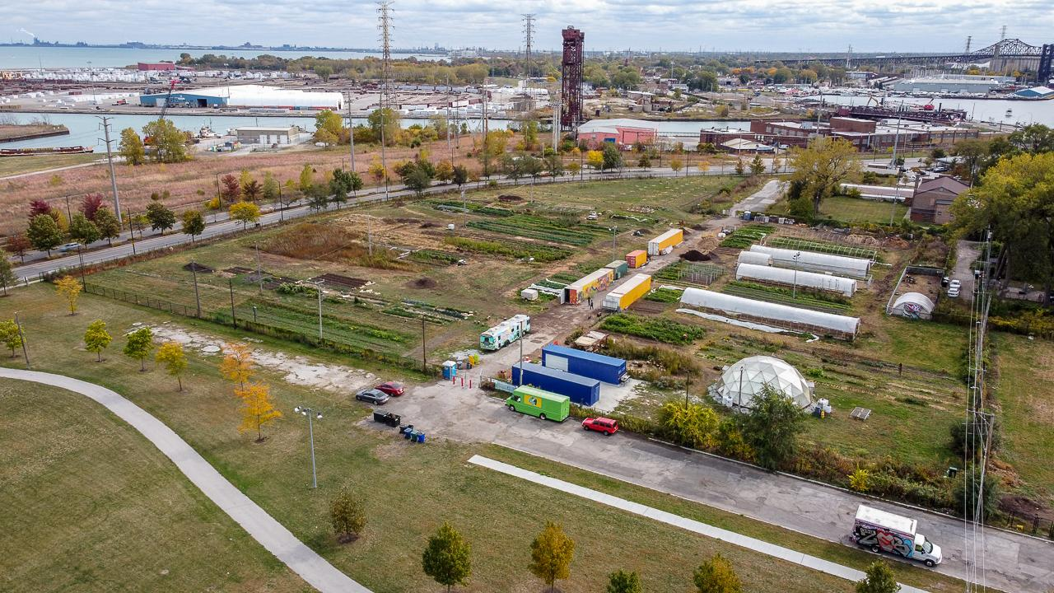
South Chicago Farm

Slide 5
Our Constellation
Apprenticeship:
Grower
Herbal
Education:
Youth Corps
Internships
Community Gardens
Public Workshops
Volunteering
Tours
Market Pathways:
Fresh Moves Mobile Markets
Farmstand
CSA
Wholesale

Slide 6
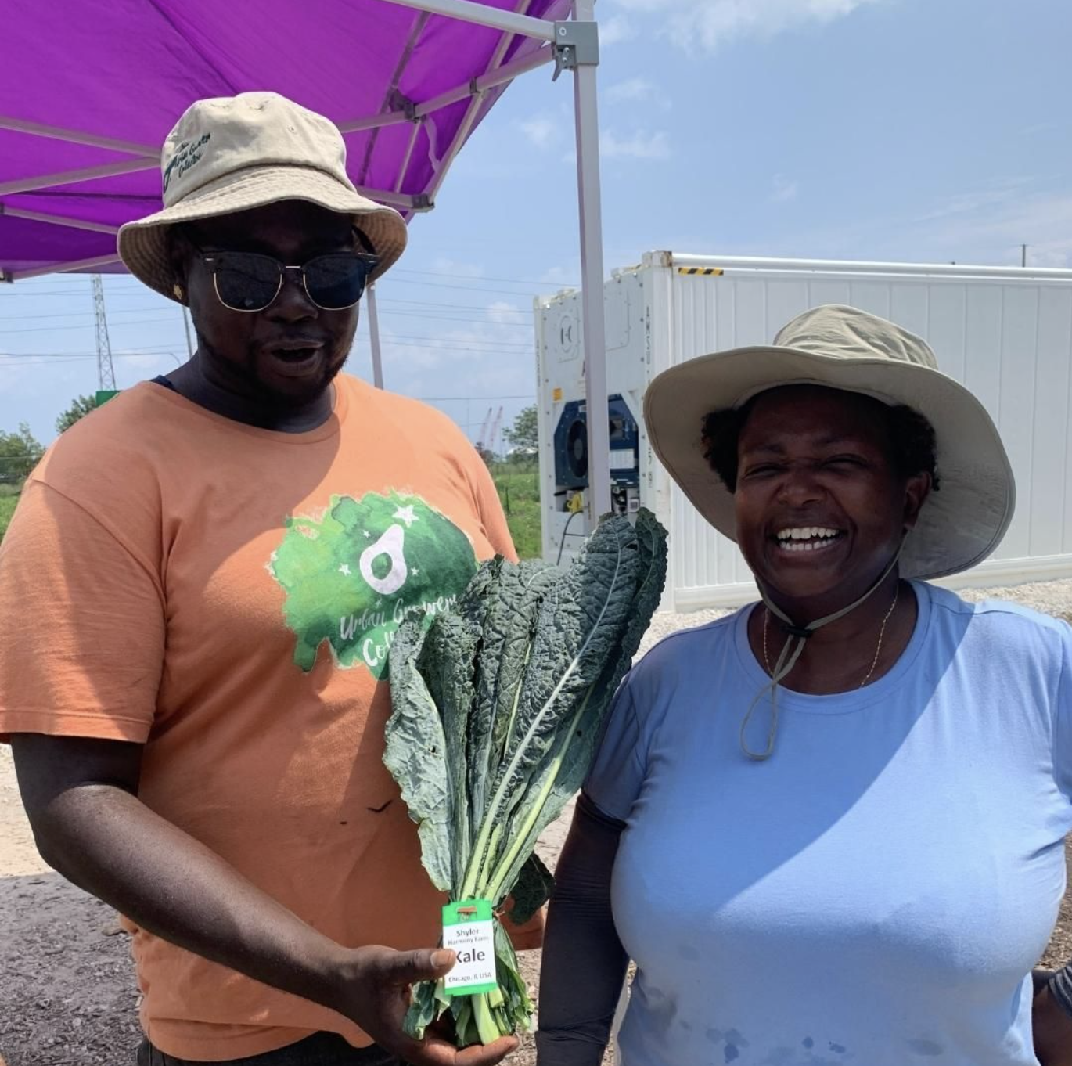
Grower Apprenticeship Overview
Urban Growers Collective’s Grower Apprenticeship Program is a 3 year farming and farm business-training program that will allow participants to: learn the hands-on fundamentals of farming, while working towards commercially viable farm operations via cooperative growing, aggregation and profit sharing.
Malcolm & Sharren (Shyler Harmony Farms)

Slide 7
Grower Apprenticeship History
The program model for the Grower Apprenticeship has evolved from UGC’s Farmer for Chicago Incubator Program, established in 2015, and is built upon the previous 13 year legacy of Growing Power’s Commercial Urban Agriculture Training Program in Milwaukee, WI.
Throughout our time supporting emerging growers, we’ve seen the need for a full spectrum, sequential training/mentoring program, that encourages new/discovery stage and emerging grower’s skill development through hand-on practice, collective knowledge sharing, and community building; without the financial pressure of starting and maintaining an independent farm business, requiring time consuming travel and related marketing expenses.

Slide 8
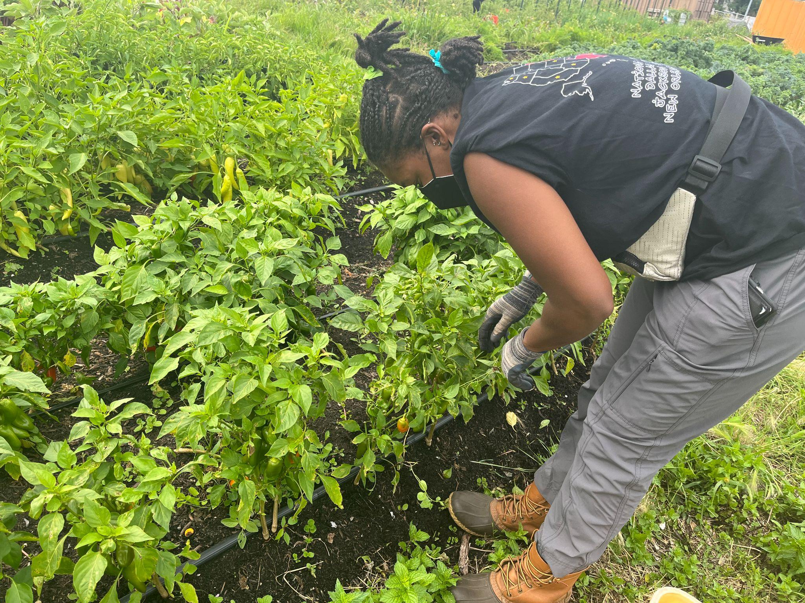
Our Training Philosophy

Slide 9
The Team
Program Leads:
Malcolm Evans
Lauralyn Clawson
Upside Down Consulting: Camille Kerr & Maru Bautista
Program Support:
Mykele Deville, Program Coordinator
Farm Team (Darion, Anthony, Siobhan, Alyssa, Gabe)

Slide 10
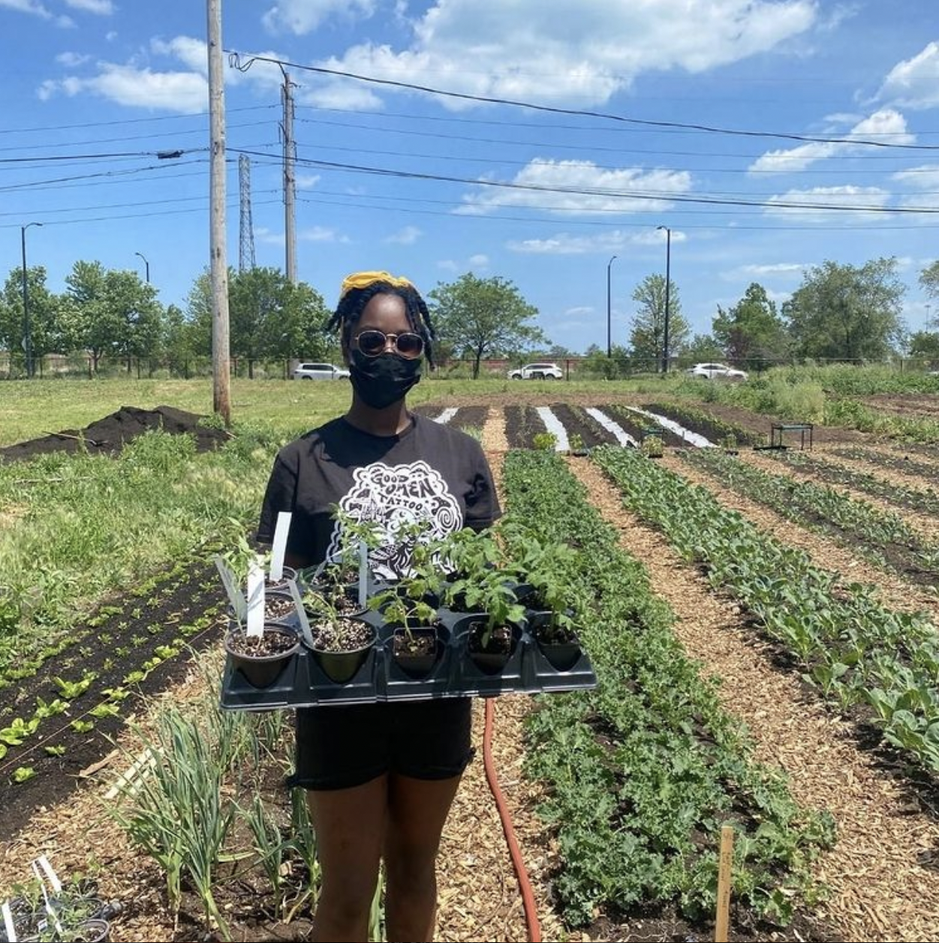
Grower Apprenticeship Structure
This practical adult education-training program is structured to introduce participants to farm foundations, through workshops, mentoring and repetitive practice, so that the basic hands-on skill are understood, while also providing scaffolded opportunities for apprentices to refine core values; build business aptitude and work toward financially, environmentally and socially sustainable farming operations.
Bweza, Sistas in the Village

Slide 11
Schedule & Time Commitment
Workshops, TA/Mentor, Group Work Days:
Wednesday Evenings - 6:00-7:30p*
Saturdays - 9:30a-11a (recommended until 4p)
Plus additional hands-on learning hours / at home study
Recommended Commitment:
At least 10 Hours Per Week, March - November 30
Notes:
Define herb walks during presentation

Slide 12
Key Components
Farm Foundation Workshops
Primarily in- person workshops with Instructor. Each session will focus on a farm foundation skill set and will provide opportunities for trainees to learn how to grow, ask questions and try on new enterprises they may want to include in their future operations.
Mentorship / Technical Assistance
In person dedicated time with UGC staff to ask questions about farm foundation skills that have been introduced, including direction and observations on farmwork needs for the day/week.
Applied Learning: Group & Self Study
Apprentices will work independently to build out designated farm space, apply farm skills, observe, learn from, tend to, and harvest produce. We have scheduled group work days to build community, collaboration and work towards shared goals.
Notes:
Define herb walks during presentation

Slide 13
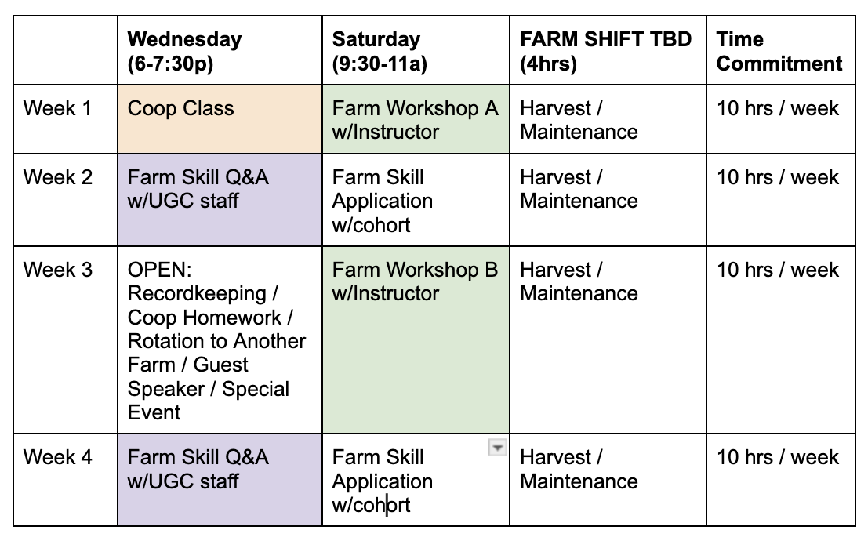
Schedule Example (Month)
Notes:
Define herb walks during presentation

Slide 14
Farm Foundations
UGC’s Grower Apprenticeship is a 10 month, hands-on program, running February-November
Spring Quarter
Bed Building
Irrigation
Transplanting
Direct Seeding
Summer Quarter
Composting
Vermicompost
Harvesting
Post-Harvest Handling
Record Keeping
Pest Management
Tomato Trellis
Crop Maintenance
Fall Quarter
Succession Planting
Season Extension
Winterizing Farm
Winterizing Irrigation
Winter Planting
Winter Quarter
Crop Planning
Greenhouse Seeding

Slide 15
Seasonal Overview
UGC’s Grower Apprenticeship is a 10 month, hands-on program, running February-November
Spring Quarter
Farm Foundation Techniques
Farm Buildout & Planting
Harvest & Post Harvest Handling
Recordkeeping
Cooperative Business Introduction
Community Building
Summer Quarter
Farm Foundation Techniques
Farm Buildout, Planting & Crop Maintenance
Harvest & Post Harvest Handling
Recordkeeping
Field Trips (Yr 2/3)
Program Rotations (Yr 3)
Community Building
Fall Quarter
Farm Foundation Techniques
Farm Buildout, Planting & Crop Maintenance
Harvest & Post Harvest Handling
Recordkeeping
Season Extension
Farm Winterization
Reflection

Slide 16
Sequential Learning Arch
UGC’s Grower Apprenticeship is a three year program, that will on board a new cohort each year. Although the program’s curriculum is designed for 3 annual modules, the learning is sequential and apprentices may choose to off board successfully each year.
Year 3 Focus:
Continued farm training
Increasing production
Financial and Production Goals; Invoicing; Understanding expenses
Increase business aptitude
Profit sharing
Market Pathway Rotation
Tracking expenses
Identifying land for future
Year 1 Focus:
Learning farm foundation skills & recordkeeping
Introduction to solidarity economy & coop principales
Collectively managing farm space
Building Community
Defining Purpose: Individual & Group
Year 2 Focus:
Continued farm training
Crop Planning
Increasing production
Refining recordkeeping
Increase business aptitude
Profit sharing
Building cooperative business model with cohort participants.

Slide 17
Coop Program
Year 1
Year 2
Year 3
Cooperative skill building
Introduction to the solidarity economy
Power & privilege
Leadership
Trust Building
Setting group values
Problem solving together
Decision-making
Redefining leadership
Generative conflict
Building facilitation skills
Cooperative planning
Building out your co-op development work plan
Business model canvas
Market research
Financial planning
Team / operational capacity planning
Membership eligibility
Designing your democratic structure (multiple sessions)
Cooperative practice
Monthly governance meetings where we practice:
Reviewing and presenting monthly financials
Discussing how to improve operations
Decision-making around strategy
Conflict transformation approaches

Slide 18
Month | Date | Focus - New Cohort | Focus - Returning Apprentices
March | 3/20 - 6:00-7:30p | Introduction, 2024 plan, SE + Co-ops 101 | Recap, 2024 plan, & Co-ops 201
April | 4/3 - 6:00-7:30p | Power & Privilege | Building out your co-op development work plan
May | 5/1 - 6:00-7:30p | Leadership | Business model canvas
June | 6/5 - 6:00-7:30p | Trust Building | Market research
July | 7/10 - 6:00-7:30p | Values | Financial planning
August | 8/7 - 6:00-7:30p | Facilitation Skills | Team / operational capacity planning
September | 9/4 - 6:00-7:30p | Conflict Resolution | Membership eligibility
October | 10/2 - 6:00-7:30p | Decision Making | Designing your democratic structure (part I)
November | 11/13 - 6:00-7:30p | Building alignment for Y2 | Designing your democratic structure (part II)
Coop Schedule and Topics

Slide 19
Levels / Certification
Level 1 - Seeds:
Introduction
Individual Expectation:
400 total program hours
Complete all Farm Foundation Workshops
Attend all Solidarity Economy / Coop Workshops
Collective Expectation:
Build out initial farm space
Regularly harvest crops
Record annual harvests
Level 2 - Sprouts:
Practice
Individual Expectation:
800 total program hours
Repeat all Farm Foundation Workshops
Contribute to all Solidarity Economy / Coop Workshops
Collective Expectation:
Cohort Coop Buildout
Increase growing space
Increase harvest volume
Level 3- Roots:
Deepen Understanding
Individual Expectation:
1200 total program hours
Repeat all Farm
Foundation Workshops
Contribute to all Solidarity Economy / Coop Workshops
Collective Expectation:
Cohort Coop Reporting
Increase growing space
Increase harvest volume

Slide 20
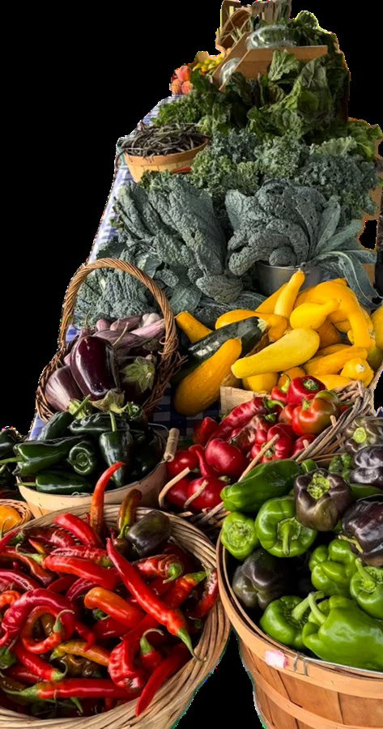
Levels / Certification
It is possible to gain each level of certificate in one calendar year. This will require a 10 hour a week commitment from ~ March 1 - November 30th (40 program weeks). A certificate will not be issued until all farm foundations have been attended and practice hours have been completed.
A certificate can be retroactively granted after the practice hours have been completed for the corresponding level.
To pursue a certificate, apprentices will be expected to accurately track hours using UGC’s time/attendance system.
It is also possible to progress in the program without receiving a certificate. Minimal attendance expectations will need to be met.

Slide 21
Attendance Expectations
The more you are present, the more you will learn.
Communication: Contact the Program Coordinator at programming@urbangrowerscollective if any conflicts arise that may inhibit you from attending class. Please notify in advance, if possible, so that accommodations may be made. If you miss more than 4 consecutive classes, without communication you may be off boarded from the program.
To progress in the program, on a non-certificate track, apprentices will need to meet the following attendance standards annually:
65% attendance in all scheduled Wednesday and Saturday Sessions
At least 75 additional hands on practice hours (average of +2hrs individual hours / week)
Offboarding from Program: Please reach to the program coordinator and program leads to let them know that you would like to offboard and the reasons why. The leads will discuss other opportunities and pathways for potential reposition if requested.

Slide 22
Tuition
The current rates for the apprenticeships are set at approximately 10% of the costs of comparable programs.
In alignment with our organizational mission and goals, our team works diligently to provide financial assistance for participants in need of further reduction in cost.
$2000 | Investor | This level of investment directly contributes to a fellow cohort members participation
$1500 | Full Cost | The full cost to participate for a season
$1200 | Reduced Cost | This level of investment is subsidized by grants and donations/mutual aid
$500 | Scholarship | This level of investment is highly subsidized by grants donations/mutual aid
$100 | Materials Fee | All Participants will be required to pay a materials fee

Slide 23
2024 Payment Schedule
All participants must pay some amount to begin participation; this includes a $100 materials fee plus first month's reservation which must be paid before the first class.
Tuition Scale | Reservation Fee | Monthly Payment (April - November) | Invoice Issued | Payment Due Date
$2000 | $200 | $225.00 | 1st of Month | 25th of the Month
$1500 | $150 | $168.75 | 1st of Month | 25th of the Month
$1200 | $120 | $135.00 | 1st of Month | 25th of the Month
$500 | $50 | $56.25 | 1st of Month | 25th of the Month

Slide 24
Invoicing
Tuition will be invoiced monthly (April - November)
Bill sent on first of the month via Quickbooks
Bill can be paid down in installments within the billed month
Monthly Payment must be closed by the 25th of the month
If payment can not be made by the 25th of the month, to continue participation - the apprentice will be responsible for reaching out to the program coordinator to propose an alternative payment plan.

Slide 25
Evaluation / Feedback
At Urban Growers Collective, we value your feedback and opportunities to continually improve the program. There are several ways to express your feedback throughout the season:
Formal Surveys: Surveys will be issued three times per season
Intake each year
Mid-way to program
End of the Year
TA/Mentorship Time: Program leads will be available to answer questions.
Program Coordinator: Your program coordinator is available to support you to reach your learning goals throughout the season.
End of Year Group Reflection: We will host an end of year group reflection session to review progress, successes and challenges from the year.
.

Slide 26
Learning Platform
Google Classroom
We will predominantly use GC for document gathering and sharing. Apprentices will receive an invite for their classroom space prior to the first onsite class.

Slide 27
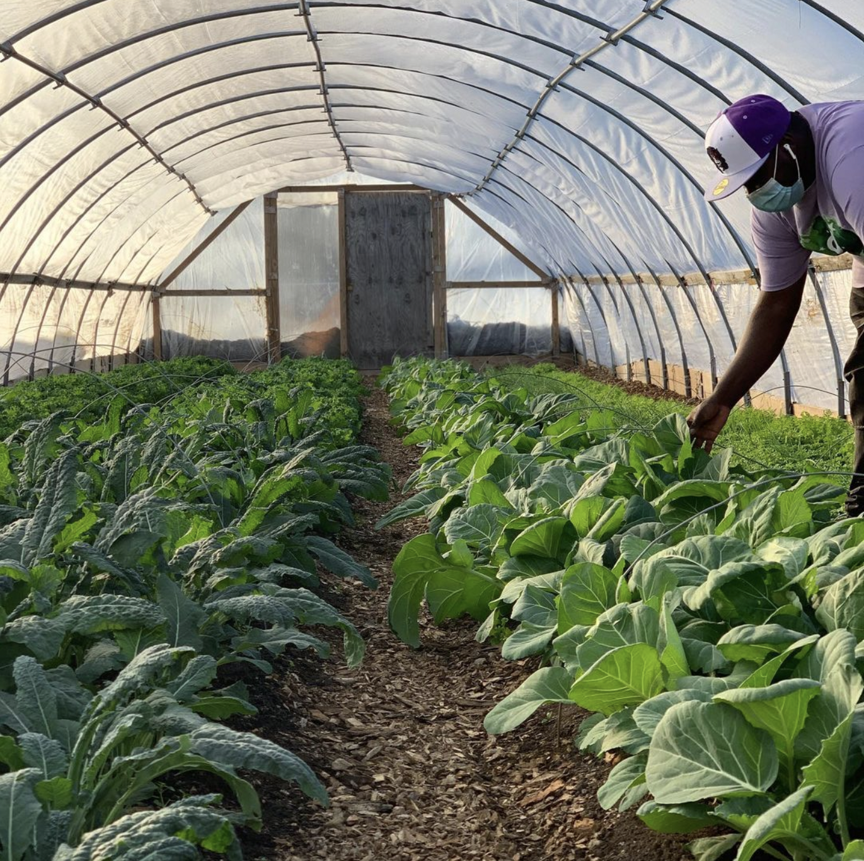
Q&A

Slide 28
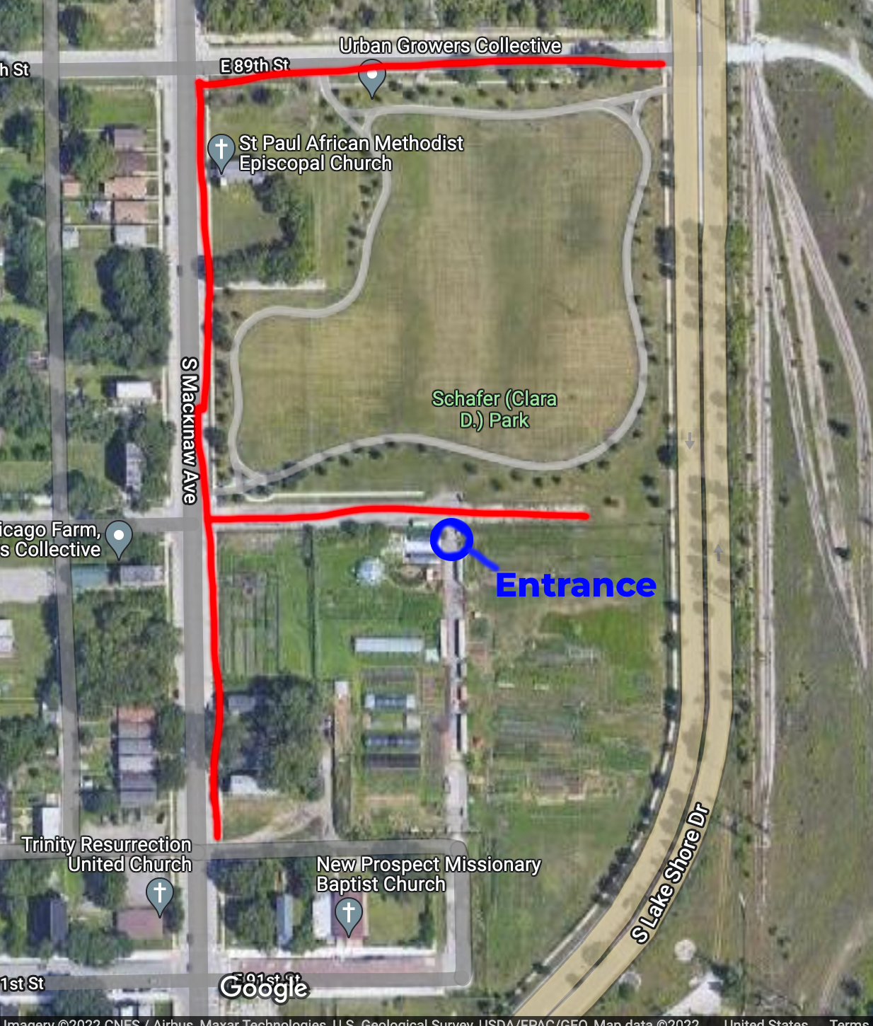
See you Saturday!
3/16
9:30 am - 11 am
South Chicago Farm, Urban Growers Collective
9000 South Mackinaw Avenue Chicago, IL 60617
Parking is free-- refer to parking map for more detailed information. Entrance is on the north side of the farm.
INSERT MAP

Slide 29
Independent Learning Opportunities
Community Garden
Jackson Park
South Chicago
10 x 10 Plot
$25 / plot
Access to water, soil, tools
Discounts on seedling sale
Light Programming
Community Building
Public Workshops
Farm Foundations
Arts, Herbalism, Culinary
Offered throughout the season
Sliding Scale Fee
Recurring Volunteers
General Farm
Harvesting
Composting
Hoophouse
Notes:
Add Recurring Volunteer opps

Slide 30
Structured Learning Opportunities
Volunteer
Free
Minimal commitment
Drop-in & Recurring
Hands-on
Contribute to needs of the farm for the day
Primary Focus: Weeding, Woodchipping, Pulling
Work alongside program staff
Community Building
Internship
10 weeks
32 hours a week
Stipend or Credit Based
Primary Focus: needs of day/season
Learn by doing on UGC farms
Opportunity to participate in UGC workshops/events
Work alongside farm staff
Community Building
Apprenticeship
10 months x 3 years
10 hours / week
Tuition Based
Dedicated farm space
Curriculum
Focus: Farm Foundations; Production; Coop Business
Learn from dedicated instructors
Community Building

